Slide 1


Skin Cancer Data Dashboard
By: Amy Ann Tran

Slide 2

Overview
Introduction Intent
Objective
Strategy Skills
Timeline
Final Statement
03
04
05
06
07
08
09

Slide 3

Purpose
I wanted to create a project that utilized healthcare data and apply my analytical skills to emphasize how important and informational data can be bridging my curiosity for data analysis and healthcare experience. Furthermore presenting extrapolated data to a broader public audience

Slide 4

Objective
I wanted to demonstrate my capabilities of using data to gain more knowledge and understanding in regards to a topic personal to me
Data Interpretation
What do I want to do?
Where can I get data from?
How do I sift through all this data?
Analysis
What information am I trying to highlight?
How do I obtain this supporting data?
Which formulas do I need?
Presentation
How can I introduce cohesiveness?
Which elements should be at the forefront?
How can I summarize findings?

Slide 5




Strategy And Troubleshooting/Debugging
SQL
Filtering through dataset to see precise information
What do I want to know from these queries?
How do I formulate queries to get what I want?
Microsoft Excel
Which formulas would be helpful to use?
What am I trying to extrapolate from this dataset?
Why are my functions not working?
Google Suite
Plan the layout of project using tools via Google Suite
Which elements should I utilize?
How do I combine elements to convey focal points?

Slide 6
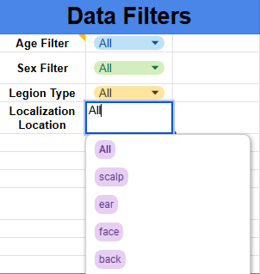
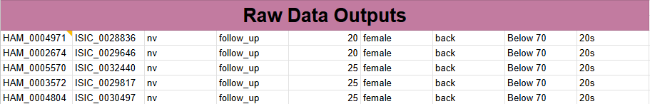
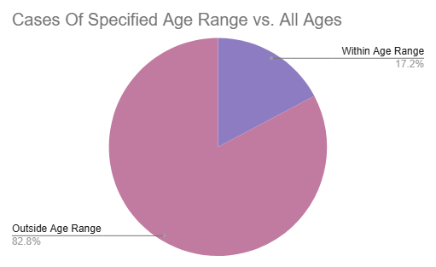
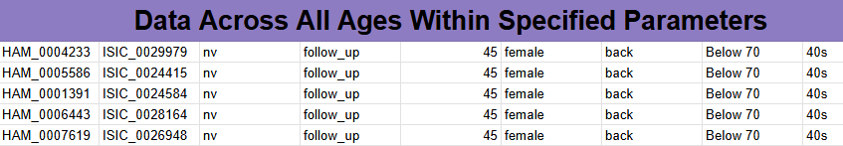
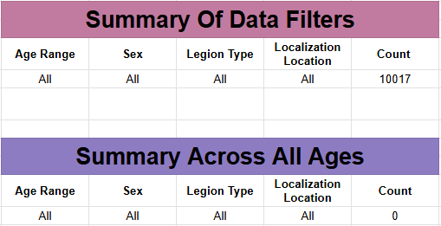
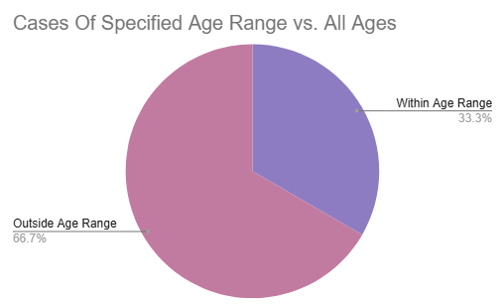
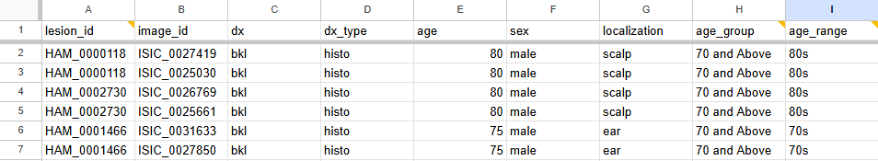
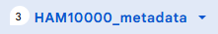

Project Elements
Created dropdown menus with filters to see entries that meet criteria. Also included summary tables to better interpret outputs
Visual dynamic chart to showcase percentage of specified cases relative to all possible cases within given parameters
Inclusion of raw data outputs to see which information is being highlighted by formulas

Slide 7




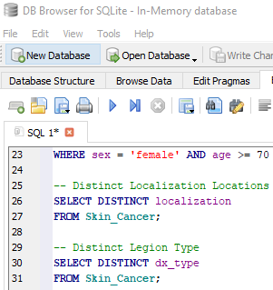
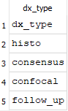
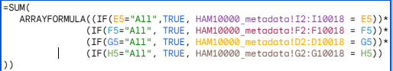
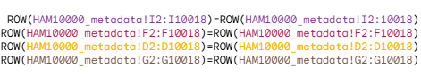
Skills Used
SQL (Structured Query Language) - Ran queries to narrow down specific data points for further analysis
Google Sheets - To showcase the project in a more representative manner
Excel - Use of multiple formulas to get tailored information
Visualization/Interpretation - A means to present my findings for better understanding
Problem 01
Which information is important to grab?
Problem 02
Which formulas do I use and why?
Problem 03
What trends can be seen from different data points?
Returned wrong value, something went wrong
Specific age range vs. All?
Why did these functions not work together?
Specific gender vs. Localization?
Specific type vs. Gender?

Slide 8
01
Pick and choose data from public resources (Outsource data from Kaggle)
02
Clean and simply data using queries for easier interpretation
Timeline Process Recap
03
Map out formula functions to aid in translating raw data into quantifiable values or categories
04
Add visual elements for better comparison between various selected data

Slide 9

THANK YOU!
Amy Tran
(206)474-9794
tran.amy.ann1@gmail.com
Seattle, WA

